Slide 2
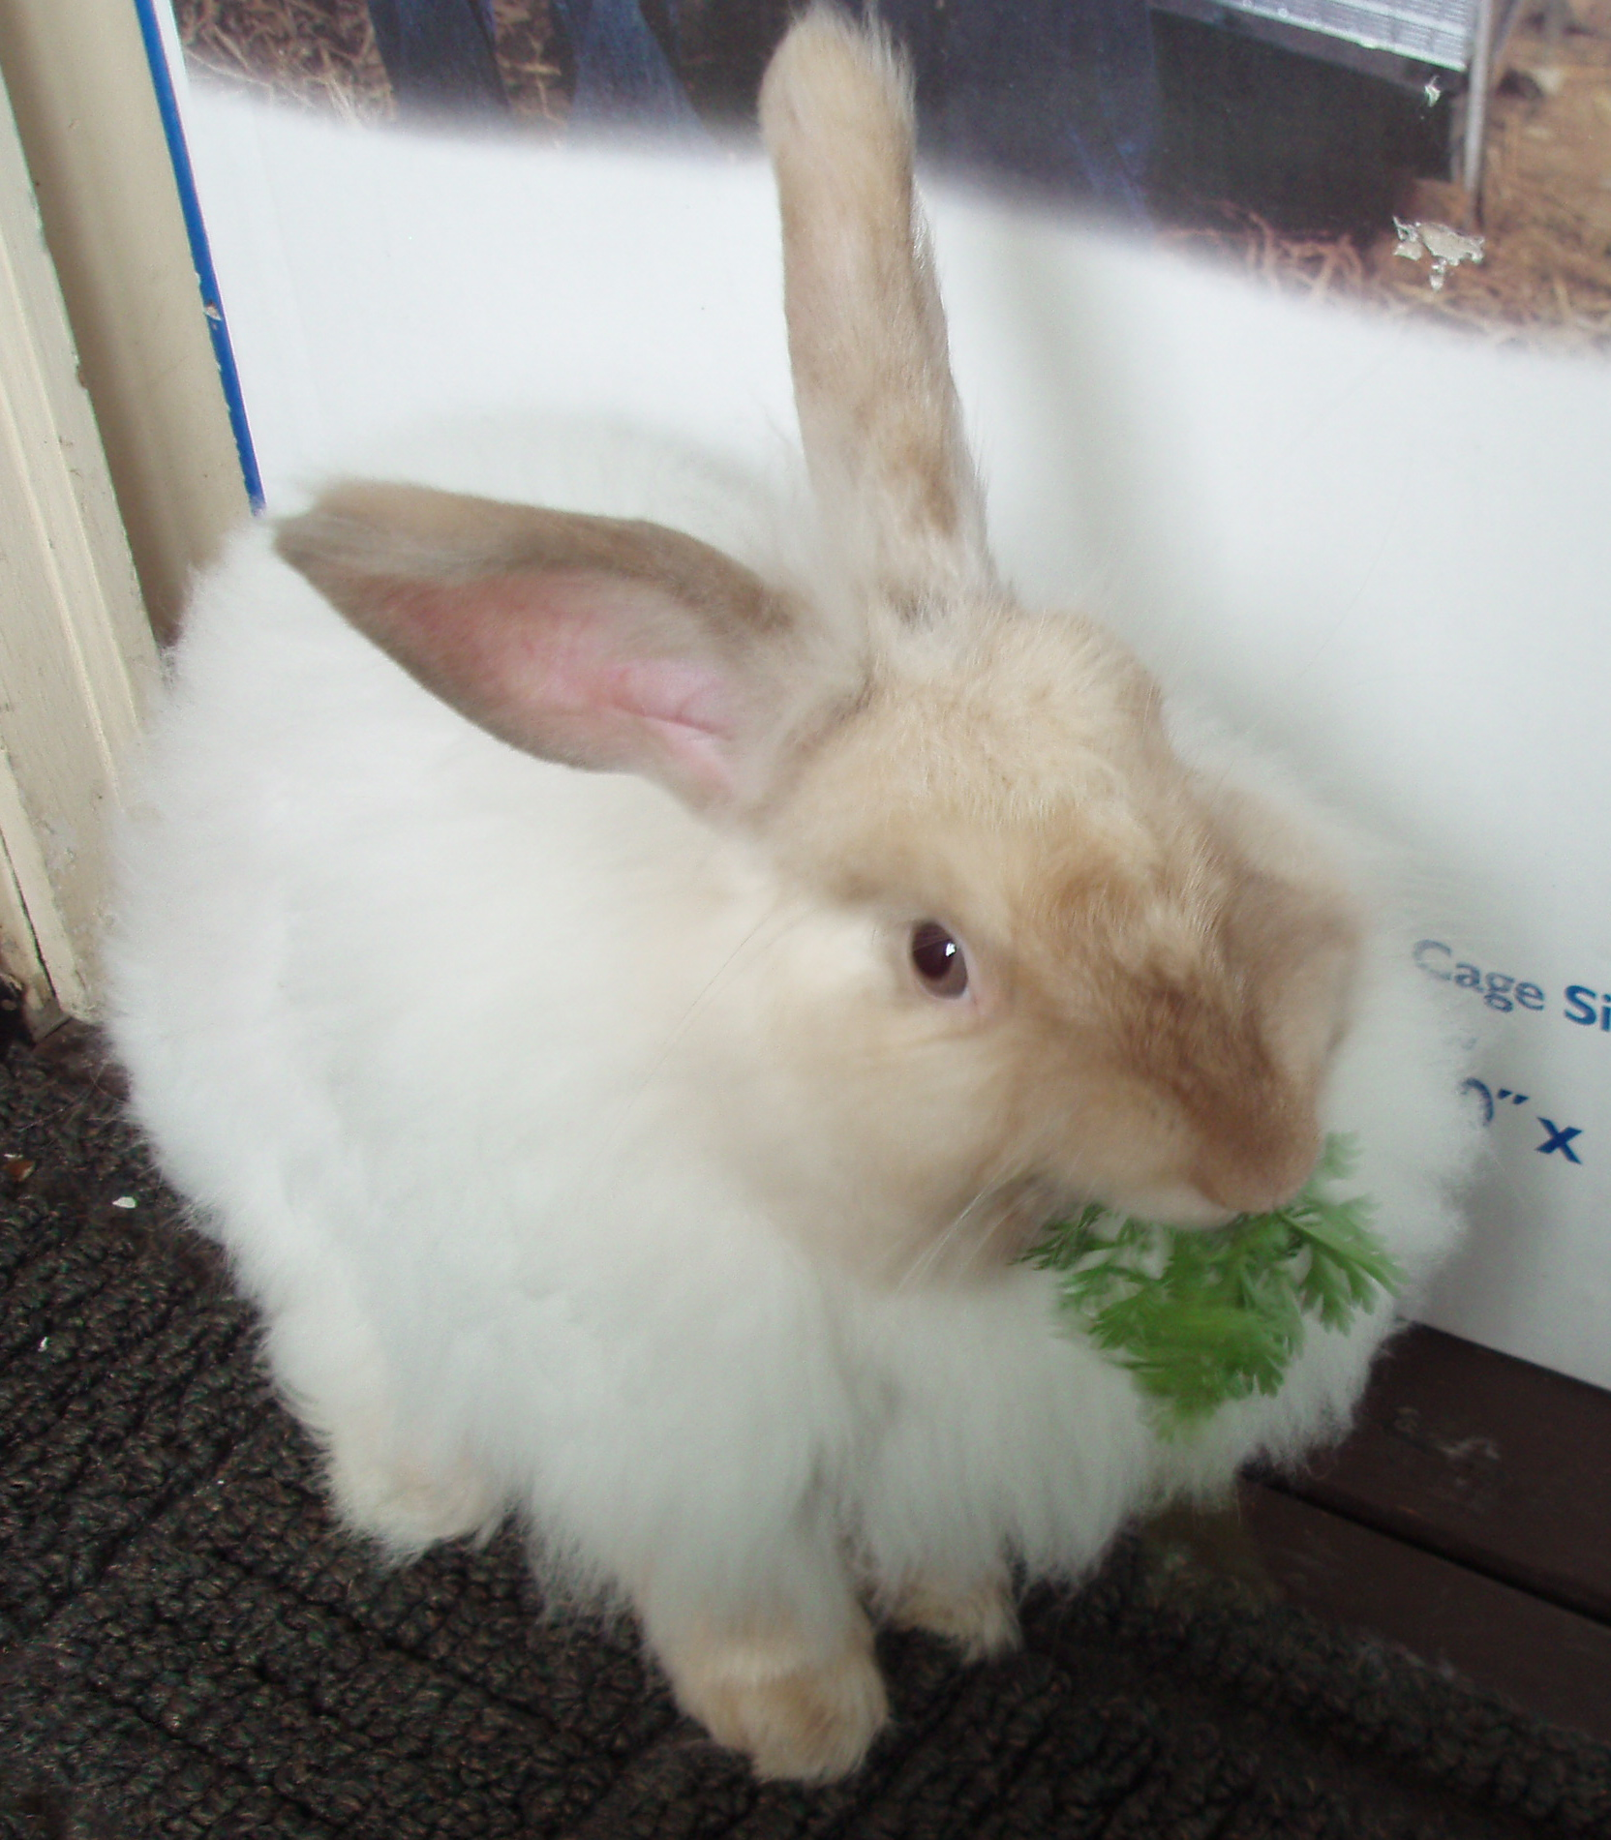
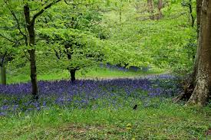
What is this a picture of?

Slide 3
Do you know the parts of a tree?
Leaves Branch Trunk Roots

Slide 4
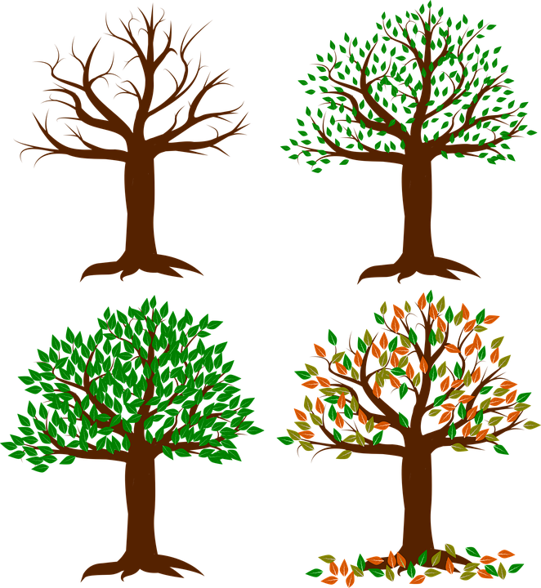
Trees through the seasons

Slide 5
Where do these animals live?
Which animals live in the wood, which live in a zoo and which live on a farm?

Slide 6
These animals live in a zoo

Slide 7
These animals live in on a farm

Slide 8
These animals live in the wood

