Slide 1
Climate change
How can Farmers reduce the impact
of food waste?

Slide 2
Key Language
food waste
primary production
food security
liquid fertiliser
food poverty
carbon
supply chain
climate change
circular economy
anaerobic digestion

Slide 3
What do you know about food waste?
Take the quiz and test yourself….

Slide 4
How much did you know about food waste?
1. B Approximately 30% of the world’s food is thrown away
2. B The UK produces approximately 15 million tonnes of food waste each year.
3. A Approximately 68% of bagged salad is thrown away every year.
4. B Approximately 50% of bakery products are thrown away every year.
5. A Approximately 20% of bananas are thrown away every year.
6. C On average, food waste costs a UK family about £700 per year.
7. A One third of our environmental footprint is due to food.
8. B People in Sub Saharan Africa and Asia thrown away 6-11kg of food each year.
9. A Only a few hundred companies control 70% of the global food market.
10. C In developing countries people spend 70% of their income on food.

Slide 5
What is food waste?
When do you consider food to have been wasted?
Is it…..
A seed that does not geminate?
the wheat in the field that’s blown down in a storm?
the bit that is left behind after the combine harvester has visited a field?
the area of the field that has been affected by pests?
in the shop when its past its sell by date?
in your fridge when you have to throw it out?

Slide 6
What is the difference between food surplus and food waste?
Food Surplus is any food and inedible parts that are…
Redistributed to people (e.g., through a charity or commercial redistributor)
Used as animal feed
Used in bio-based materials/biochemical processing (e.g. feedstock for other industrial products)
Food Waste is any food and inedible parts….
Sent to an Anaerobic Digestor
Used in composting/aerobic processes
Not harvested/ploughed in
Placed in an Incinerator
Disposed of as sewer waste/water treatment
Notes:
Definitions provided by WRAP (The Waste and Resources Action Programme)
What we do | WRAP

Slide 7
Notes:
Watch the video from the United Nations – Food Wastage Footprint (Food wastage footprint – YouTube)– to discover how food waste contributes to climate change and some of the many ways in which food waste can be reduced.

Slide 8
Notes:
UK Food Waste in Primary Production 2017 estimate compared to other stages in supply chain in 2015 (other stages taken from Courtauld Commitment 2025 Food Waste Baseline for 2015, WRAP 2018)7 - Technical report templates (wrap.org.uk)

Slide 9
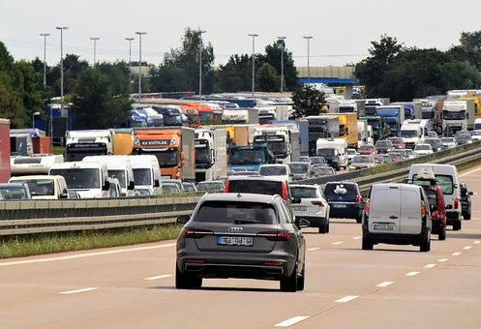
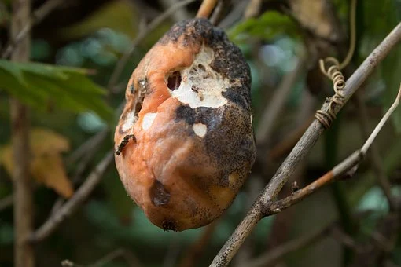
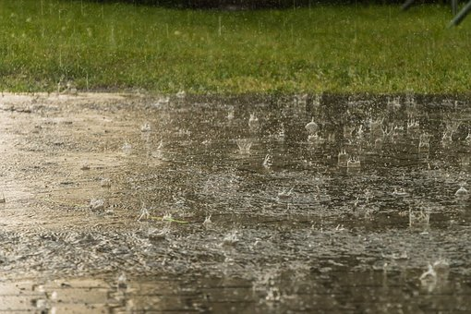
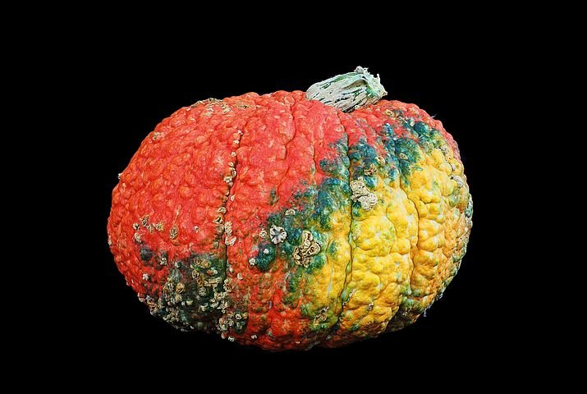
Why is food wasted in primary production?
After dedicating time and resources to growing a crop, farmers often struggle to sell all of it, even though it is perfectly edible and delicious. This can be for several reasons:
Retailer policy means that their produce is not of good enough quality
Consumer tastes change
Market unpredictability means that there is excess supply and not enough demand
Weather means that the crop is ready too early or too late for the market’s needs.
Can you think of any other reasons why a farmer may have excess produce?

Slide 10
Sainsburys Global Farm Video:
Take a look at Symington’s Wine
You can also search on the global map for ‘food waste’ and see what else farmers are doing to reduce.
Notes:
Visit: Sainsburysglobalfarm.com

Slide 11
Notes:
Watch the video - Food waste recycling - creating a circular economy – YouTube – to learn about GENeco and how they use food waste to fertilise fields and to produce energy.

Slide 12
How can farmers help prevent climate change?
Many farmers are working very hard to minimise waste at the supply stage, and minimise climate change, using food waste to help store carbon in the soil.
Grass fields store carbon all year round, and when fertilised using liquid fertiliser, made from food waste, farmers are making a real difference in the fight against climate change.
How would you minimise food wastage if you had a farm?

