Slide 1
Learning Objectives
What are the causes of the Wainfleet, Lincolnshire floods in June 2019?
Understand the difference between physical and human causes and give examples.
What are the impacts of flooding upon the people, businesses and environment of The Fens?
Use 2019 Wainfleet floods case study to identify economic, environmental and social impacts.
3. What are the different types of hard and soft engineering techniques?
Understand that each method has benefits and drawbacks.

Slide 2
https://create.kahoot.it/details/238715fd-75d4-46be-a544-b677b8fcc68d

Slide 3
Task 1
Read through source A and B in the resource booklet and in small groups or pairs identify examples of physical and human causes of flooding in the Fens.
Physical
Human

Slide 4
Physical causes of flooding – Wainfleet, Lincolnshire:
Prolonged heavy rainfall saw 2.5 times the monthly average fall between 10-12 June 2019 in parts of Lincolnshire causing overtopping of the bank and a breach on the relief channel
The surrounding land is reclaimed from peat and marshland, lying only slightly above sea level and below the height of the embanked river and Relief Channel.
Overflowing surface water and foul drainage systems caused by excessive rainfall and water flow
Accumulation of silt in the relief channel potentially contributed to water levels reaching higher levels sooner
Notes:
2.5 times the monthly average – See Met Office https://www.metoffice.gov.uk/about-us/press-office/news/weather-and-climate/2019/ffc-10th-anniversary
Source – causes of flooding - https://www.lincolnshire.gov.uk/downloads/file/3483/wainfleet-flood-investigation-report

Slide 5
Human causes of flooding - Wainfleet, Lincolnshire:
The embankments of the relief channel lacked the protection of modern flood defences
Areas of the river bank had been grazed by cattle and rutted by their hooves and vehicles, which may have caused weakening, making it more susceptible to breaching
Relief channel had higher water levels kept for water abstraction in the summer months
Notes:
https://www.e-lindsey.gov.uk/media/16099/2020-Steeping-Catchment-Action-Plan/pdf/2020__Steeping_Catchment_Action_Plan
wainfleet-flood-investigation-report (lincolnshire.gov.uk)

Slide 6
Task 2
In small groups or pairs read through the pack of cards which outline some impacts of the 2019 floods in Wainfleet, Lincolnshire. Sort into three groups:
Economic
Environmental
Social
Notes:
https://www.itv.com/news/calendar/2020-02-14/lincolnshire-flood-report-says-cattle-could-be-partly-responsible-for-weakened-defences – RAF bag drops

Slide 7
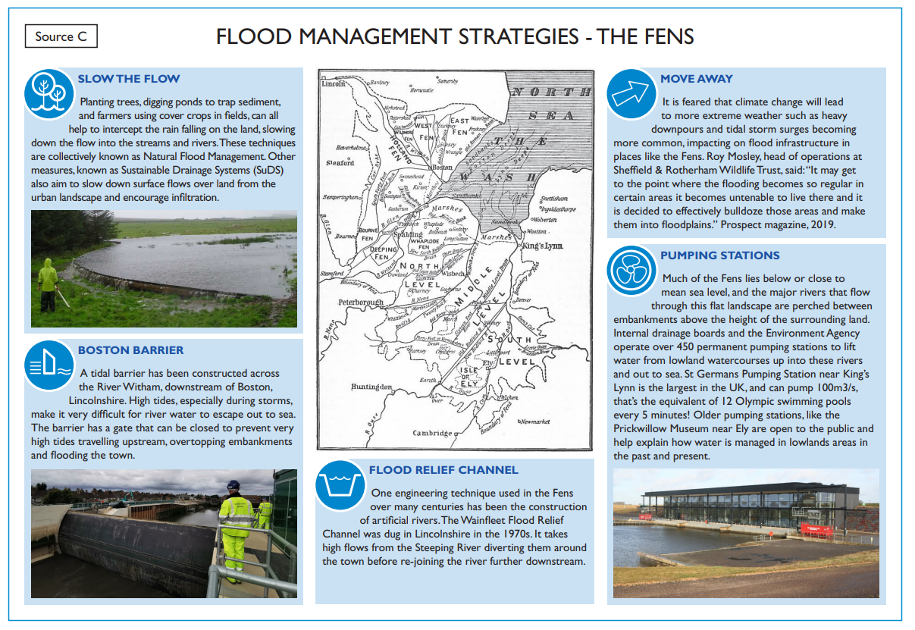
Task 3
Read through Source C - Flood
Management Strategies in
the Fens and answer the questions
on the skills question sheet.

Slide 9
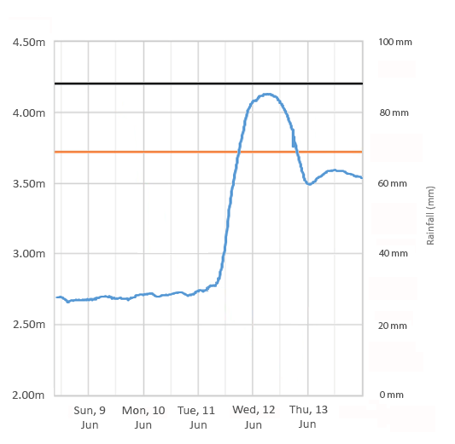
A flood hydrograph to show rainfall and discharge for the Steeping River, Lincolnshire.
Lag Time

Slide 10
 | Sun 9 Jun | Mon 10 Jun | Tue 11 Jun | Wed 12 Jun | Thu 13 Jun | Average
Rainfall | 0 mm | 32 mm | 77 mm | 30 mm | 12 mm | 30.2 mm

Slide 11
What have we learned?
Do you understand the difference between physical and human causes of flooding and give examples?
Hold up your red, amber or green card.
Can you identify economic, environmental and social impacts?
Hold up your red, amber or green card.
Can you give examples of hard and soft engineering techniques?
Hold up your red, amber or green card.
Do you understand that each method has benefits and drawbacks ?
Hold up your red, amber or green card.

