Slide 1
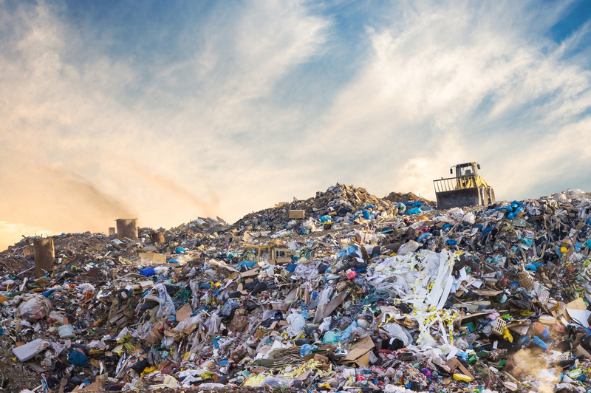
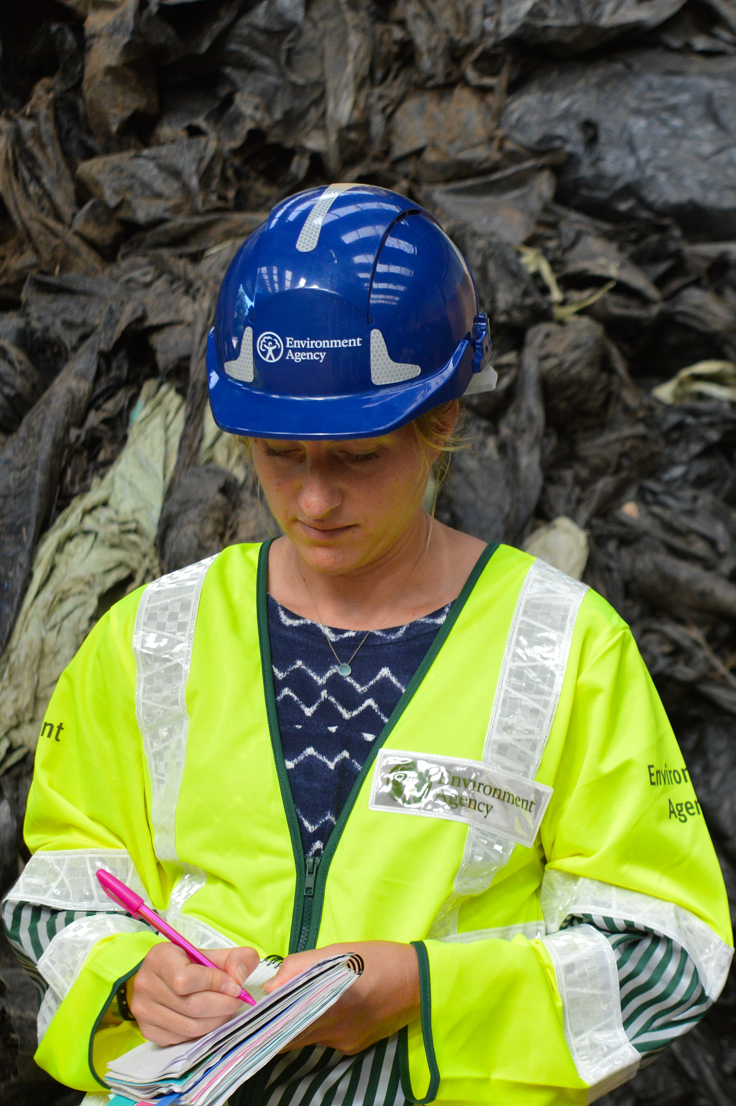
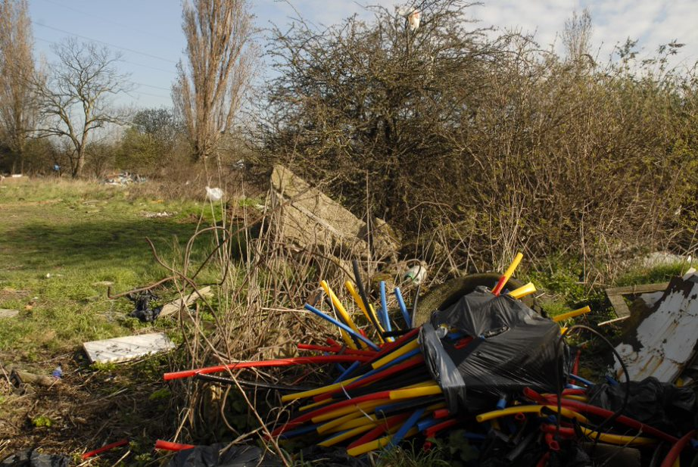
Plastics used in the horticulture industry: Lecture 3

Slide 2
Plastics in the horticulture industry: Course learning outcomes
Describe how plastics are used in the horticulture industry
Using mulch film and tree guards as case studies, explain the potential environmental impact of plastic use
Outline waste management legislation and regulation within horticulture

Slide 3
Lecture 3: Waste management learning outcomes
Describe the waste hierarchy
Outline waste regulation using examples of good waste management, and waste crime as a consequence of poor waste management
Apply the waste hierarchy to the horticulture industry

Slide 4

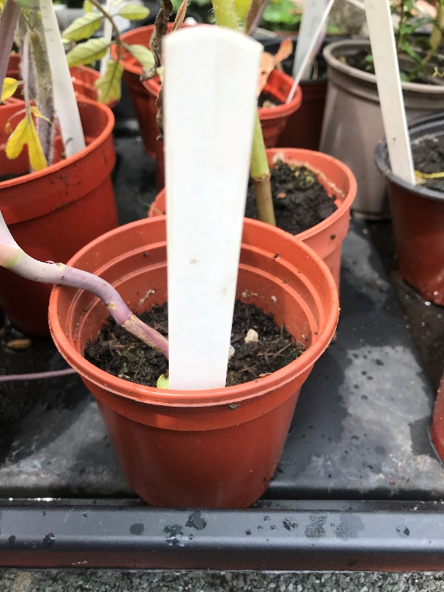
5 minute recap
Recall two different plastics used in the horticulture industry
List two suggestions to minimise plastic loss to the environment from horticultural practices

Slide 5
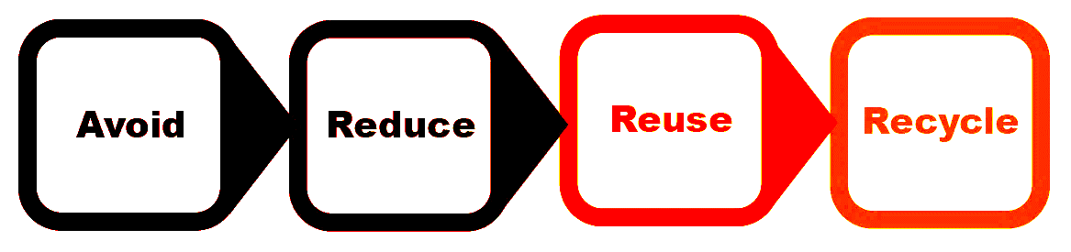
How to minimise waste
The waste hierarchy
Notes:
Strictly speaking avoid is not part of the waste hierarchy but included to start thinking about which plastics we can avoid using
The Waste Hierarchy provides a benchmark to address waste control
This relates to all farm waste streams including SSAFO (silage, slurry and agricultural fuel oil ) regulations.
The same with any business environment, farmers have a duty of care over inputs and waste streams.
The development of a waste management plan describing how waste is dealt with is something that will become essential to modern farming rules.
The financial benefits of reducing farm inputs and waste outputs are increasingly important where farm budgets are squeezed.

Slide 6
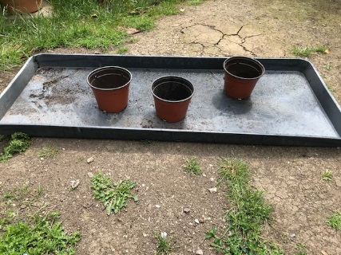
Waste hierarchy
Avoid
Do you need it and does it need to be made of plastic?
Reduce
Can you buy fewer bigger bags?
Can you purchase items with less unnecessary packaging?
Reuse
Can you reuse or fix something you have already?
Can you get something second hand that someone else no longer needs?
Can you buy more durable products that are designed to be reused more times?
Do your suppliers offer a refill/take-back scheme? If not, can you ask for one?
Notes:
Change to activity- following the example from agriculture

Slide 7
Waste hierarchy continued
As a last resort recycle
Choose materials that can be easily recycled e.g. where different types of plastic can be easily separated and sorted
Make sure waste is properly cleaned and segregated to support recycling efforts
Plant pots that are carbon pigment free (e.g. taupe coloured) may be more easily recycled
Notes:
Refer to task 4 on the student worksheet
Examples if students struggling: Birch Farm Plastics / Solway recycling
Agri-Cycle http://www.agri-cycle.uk.com/product-category/recycled-plastic/
BPI https://www.bpirecycling.co.uk/what-we-recycle - make refuse sacks
Farm XS: car body parts, bin liners, builders’ membrane, road cones, garden furniture, plastic sheeting and coat hangers.

Slide 8



Whose responsibility is it to manage land based waste?
Examples of different waste:
Compost bags, plant pots, tree guards
Ensure:
Waste is stored securely on site
Whoever collects your waste is registered with the EA
You know where your waste is going
  Waste to energy
  Landfill
  Recycled
Notes:
It is your responsibility as the waste producer to manage land based waste. Under duty of care legislation you are responsible for managing your waste – keeping it secure(so it doesn’t get blown into trees or washed into rivers) and ensuring it is collected by an EA registered waste carrier. You can check here: Waste carriers, brokers and dealers (data.gov.uk)
Ask Fiona to clarify or more details in notes

Slide 9
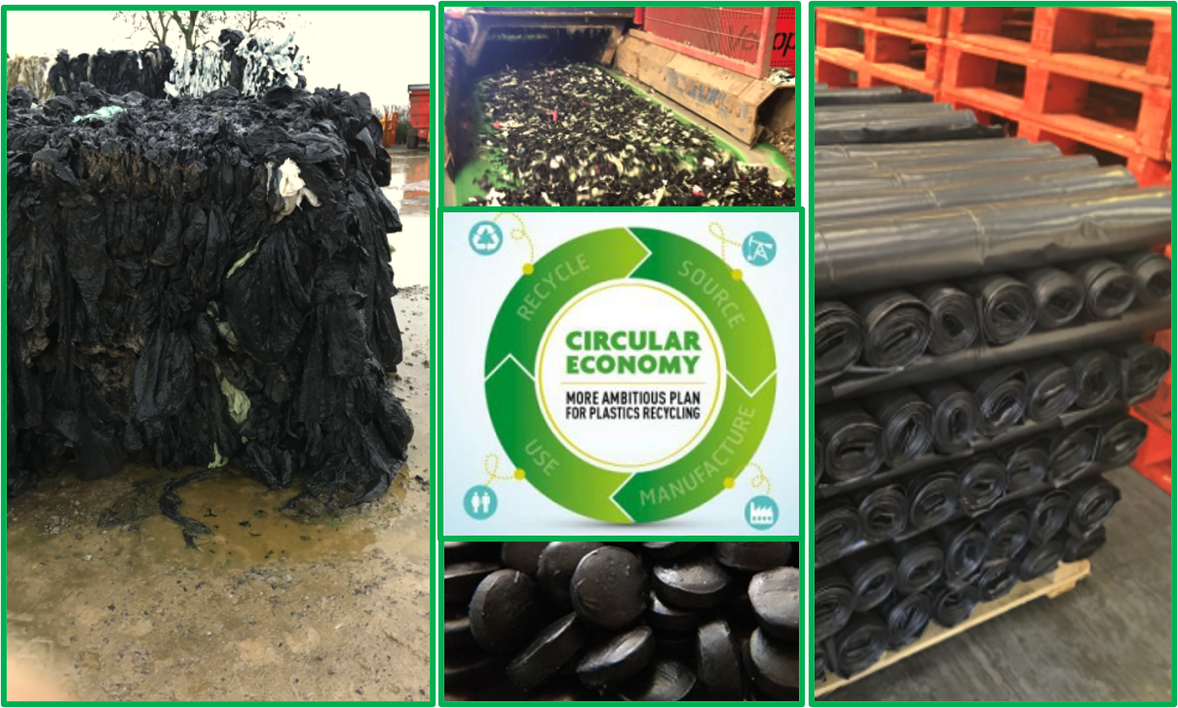
What is good waste management?
Separate and sort it
Keep it clean
Keep it dry
Keep it contained
Compact it where possible to maximise storage
Have it collected by an EA registered waste collector
For more information on your waste duty of care and rules for storing and moving your waste visit gov.uk.

Slide 10
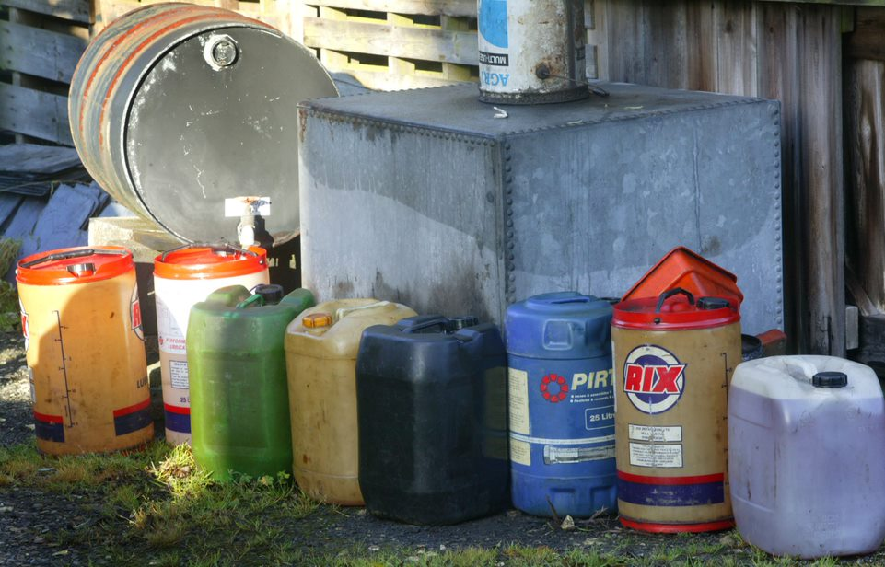

The rules on plastic waste: Dealing with hazardous waste
What kind of waste items do you think are classified as hazardous? Why?
Unrinsed pesticides containers
Oil containers
Fertiliser bags
You can manage pesticide containers as non-hazardous if they’ve been triple rinsed according to industry best practice guidance.
Keep hazardous waste to a minimum. Mixing hazardous waste with non-hazardous waste is illegal unless you have a permit covering this. For more information visit gov.uk.
Notes:
Gov.uk – hazardous waste segregation: www.gov.uk/guidance/hazardous-waste-segregation-and-mixing
Hazardous waste - GOV.UK (www.gov.uk)

Slide 11
The rules on packaging waste: UK producer responsibility regulations
There are specific regulations called Producer Responsibility Regulations setting recycling targets for businesses producing packaging waste such as pallet wrap and some plant pots
Companies that produce or use packaging in the UK are responsible for contributing towards the costs of recycling or recovering that material
The regulations are designed to fund new facilities for recovering waste, and reduce the amount of packaging going to landfill
To find out if producer responsibility regulations apply to your business and to get the latest guidance always check gov.uk
https://www.gov.uk/guidance/packaging-producer-responsibilities

Slide 12
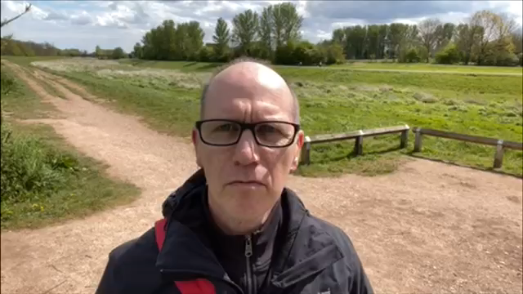
Case studies: Waste disposal

Slide 13
Examples of poor waste management or waste crime
Burying
Fly tipping
Burning
Notes:
Ask the students for examples of waste crime or poor waste management of plastics from land based industries

Slide 14
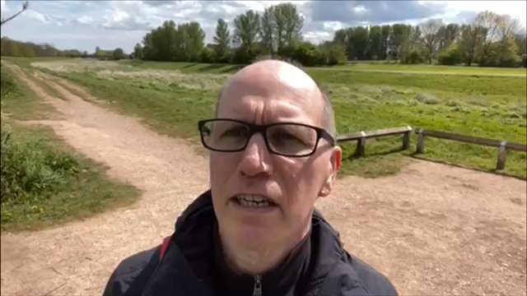
Case studies: Illegal waste disposal

Slide 15
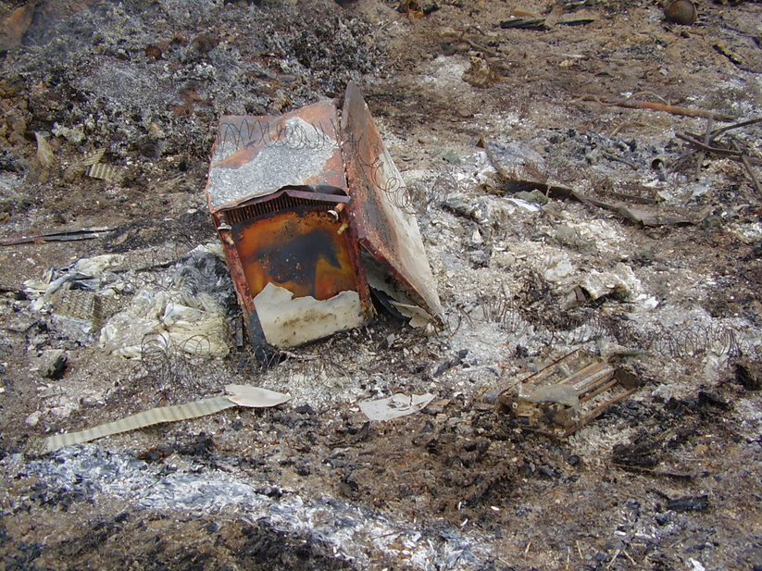
Activity: Example of waste crime
10 minutes
We all have a duty of care to make sure the plastic waste created from the horticulture industry is correctly managed and disposed of
You will need one worksheet per group
Task
In small groups identify the form of waste crime, and consequences of poor waste management
Describe how this waste crime and plastic pollution could be prevented
Notes:
In groups of 3 or 4

Slide 16

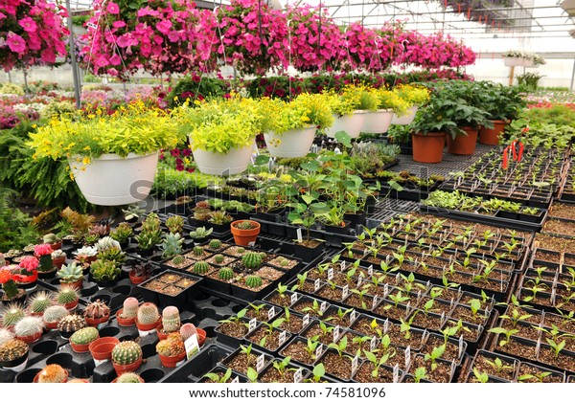
Case study: Plant pots
In 2001 the High Court ruled that plastic plant pots constitute packaging, and consequently convicted Hillier Nurseries in Romsey of contravening European packaging waste regulations
Hillier Nurseries thought that plastic plant pots did not fall into the relevant category
The Environment Agency explained that plant pots intended to have plants permanently kept in them are not considered by the EA to fall under the regulations. But if you go into your local garden centre and buy a plant for your garden, or buy plants in a seed tray, this type of packaging is covered by the regulations
Notes:
High Court convicts nursery of wrongful disposal of plant pots (edie.net)

Slide 17
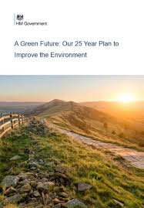
What are we doing?
The UK Government 25 Year Environment Plan sets a goal of achieving zero avoidable plastic waste by 2042
The UK Government has set a target of achieving net zero greenhouse gas emissions by 2050, so emissions from plastic production and waste treatment will need to decline
New risks may be emerging from microplastics. Microplastics are held in soils and river sediments before eventual release to rivers and the oceans. Research on their impact is ongoing
Notes:
As a team this is what we are doing to support the delivery of government aims to avoid and reduce the creation of plastic waste.

Slide 18
What can you do?
Identify one thing you can:
Avoid
Reduce
Reuse

Slide 19

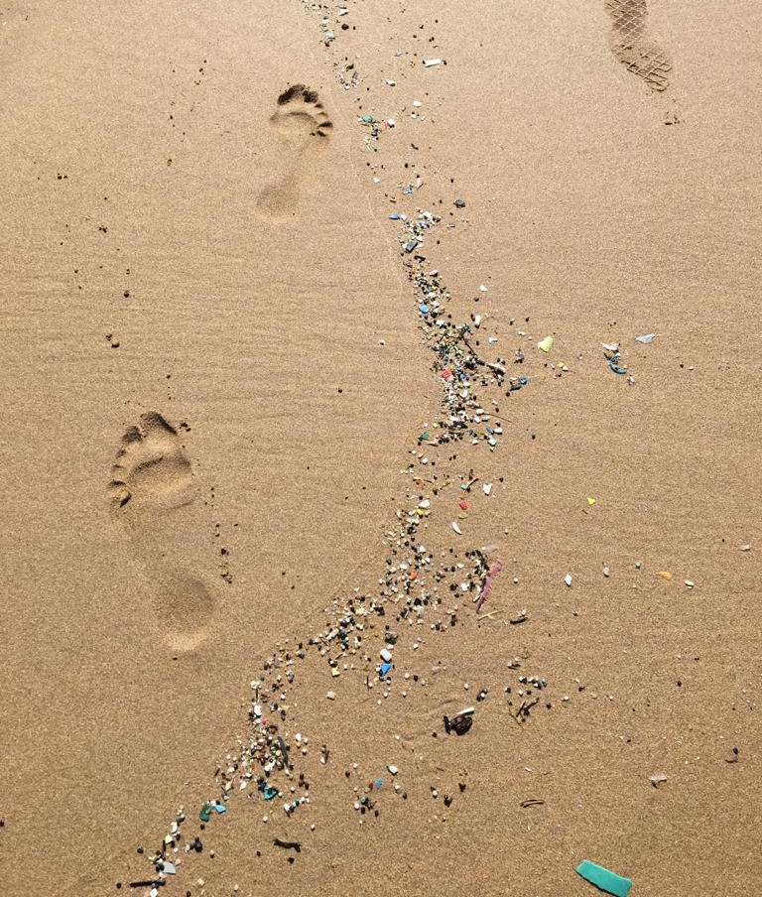
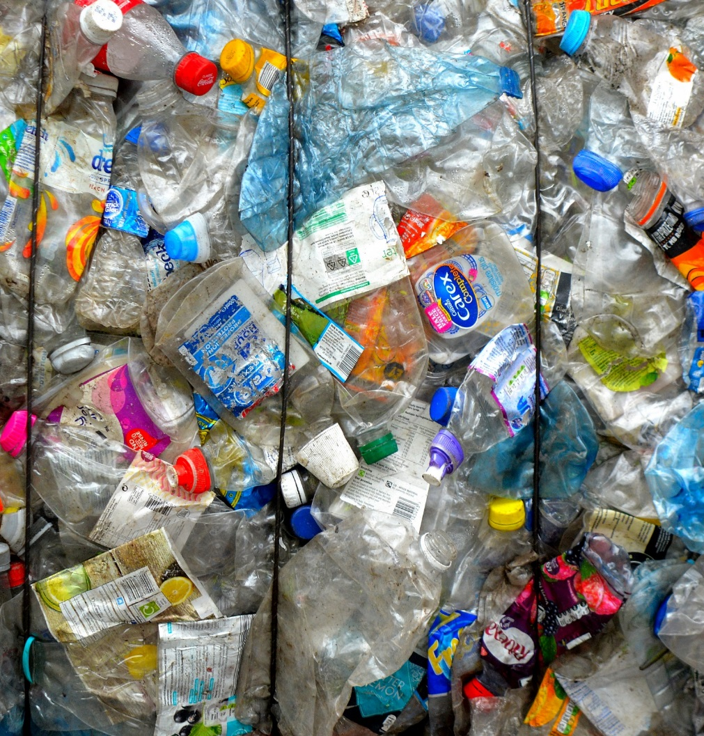
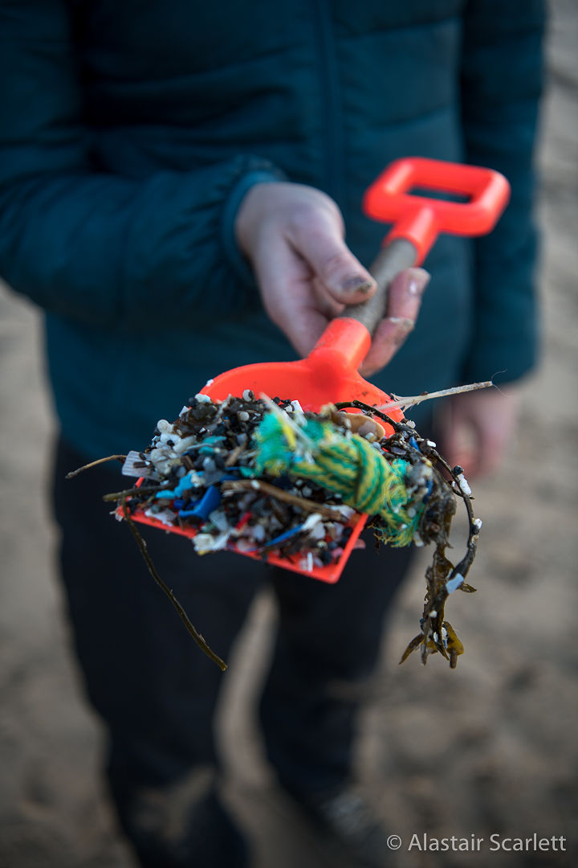
Solutions- what can you do?
Tell a friend or family member
Take part in a survey or a litter pick
A future job?

Slide 20
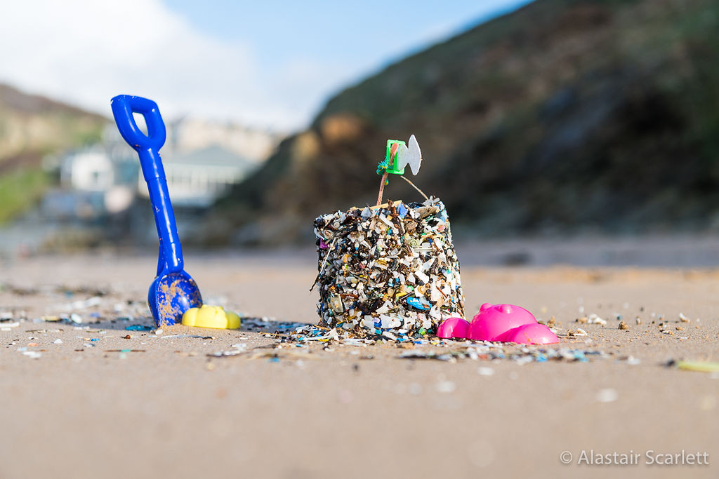


Feedback and contact
Social media
Website
Slido survey for feedback and pledge
@plastic_eu
https://preventingplasticpollution.com/
#PPPHorticulture
Notes:
Ask the students to either scan the QR code or go to slido.com and use the login PPPHorticulture to complete the feedback sheet

Slide 21
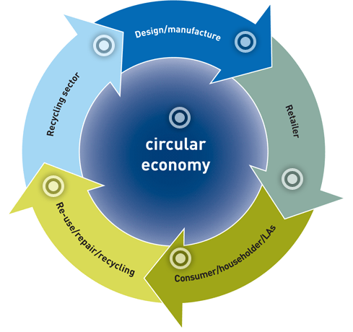
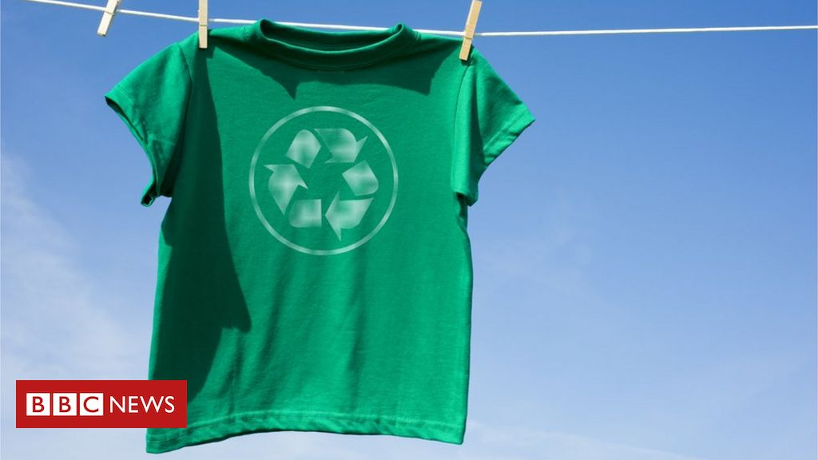
What will the future look like?
Circular economy
Image courtesy of WRAP
Notes:
A circular economy is an alternative to a traditional linear economy (make, use, dispose) in which we keep resources in use for as long as possible, extract the maximum value from them whilst in use, then recover and regenerate products and materials at the end of life.
Why a circular economy is important
new opportunities for growth
reduce waste
drive greater resource productivity
deliver a more competitive UK economy
position the UK to better address emerging resource security/scarcity issues in the future.
help reduce the environmental impacts of our production and consumption in both the UK and abroad.
http://www.wrap.org.uk/about-us/about/wrap-and-circular-economy
Good case study is VIGGA which is a children’s clothing rental scheme, designed to last and you are sent a bundle of clothes as the child grows and return the smaller sized bundle which is then redistributed.

Slide 22
What will the future look like?
Circular economy in practice
Extension activity 1
Consider one use of plastics in the horticulture industry, can you think of a new approach to this practice that could reduce waste and drive a more circular economy, to protect the environment and ensure the industry contributes to a sustainable future?
Notes:
We suggest this activity as a home work / extension activity to help consolidate everything the students have learned over the last three lectures and apply that learning directly to scenarios they are likely to face

Slide 23

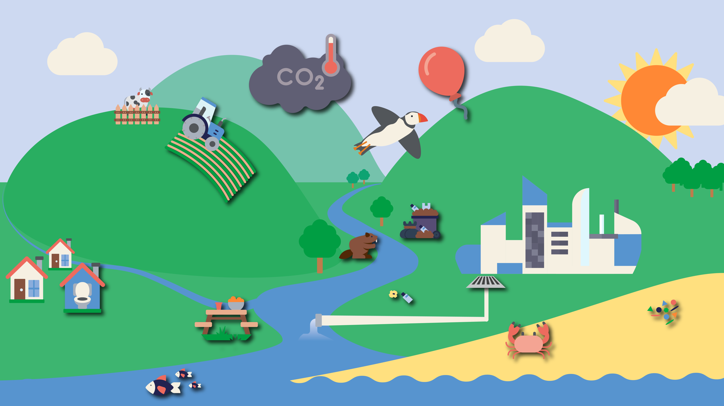

Further resources
Notes:
Hyperlinked to PPP- interactive map
Partner and resources on countryside classroom and more to come
Activities, competitions and curve module with NFYFC

Slide 24

Extension Activity 2: Regulations in Practice
In groups read one of the four waste scenarios provided, how would you deal with the waste in each example? You may need to research using some of the links provided. For each case think about:
Potential pathways that could result in plastic escaping into the environment
How you could follow the waste hierarchy to minimise the amount of plastic waste produced
How you would mange the waste and ensure you follow the waste duty of care regulations

