Slide 2
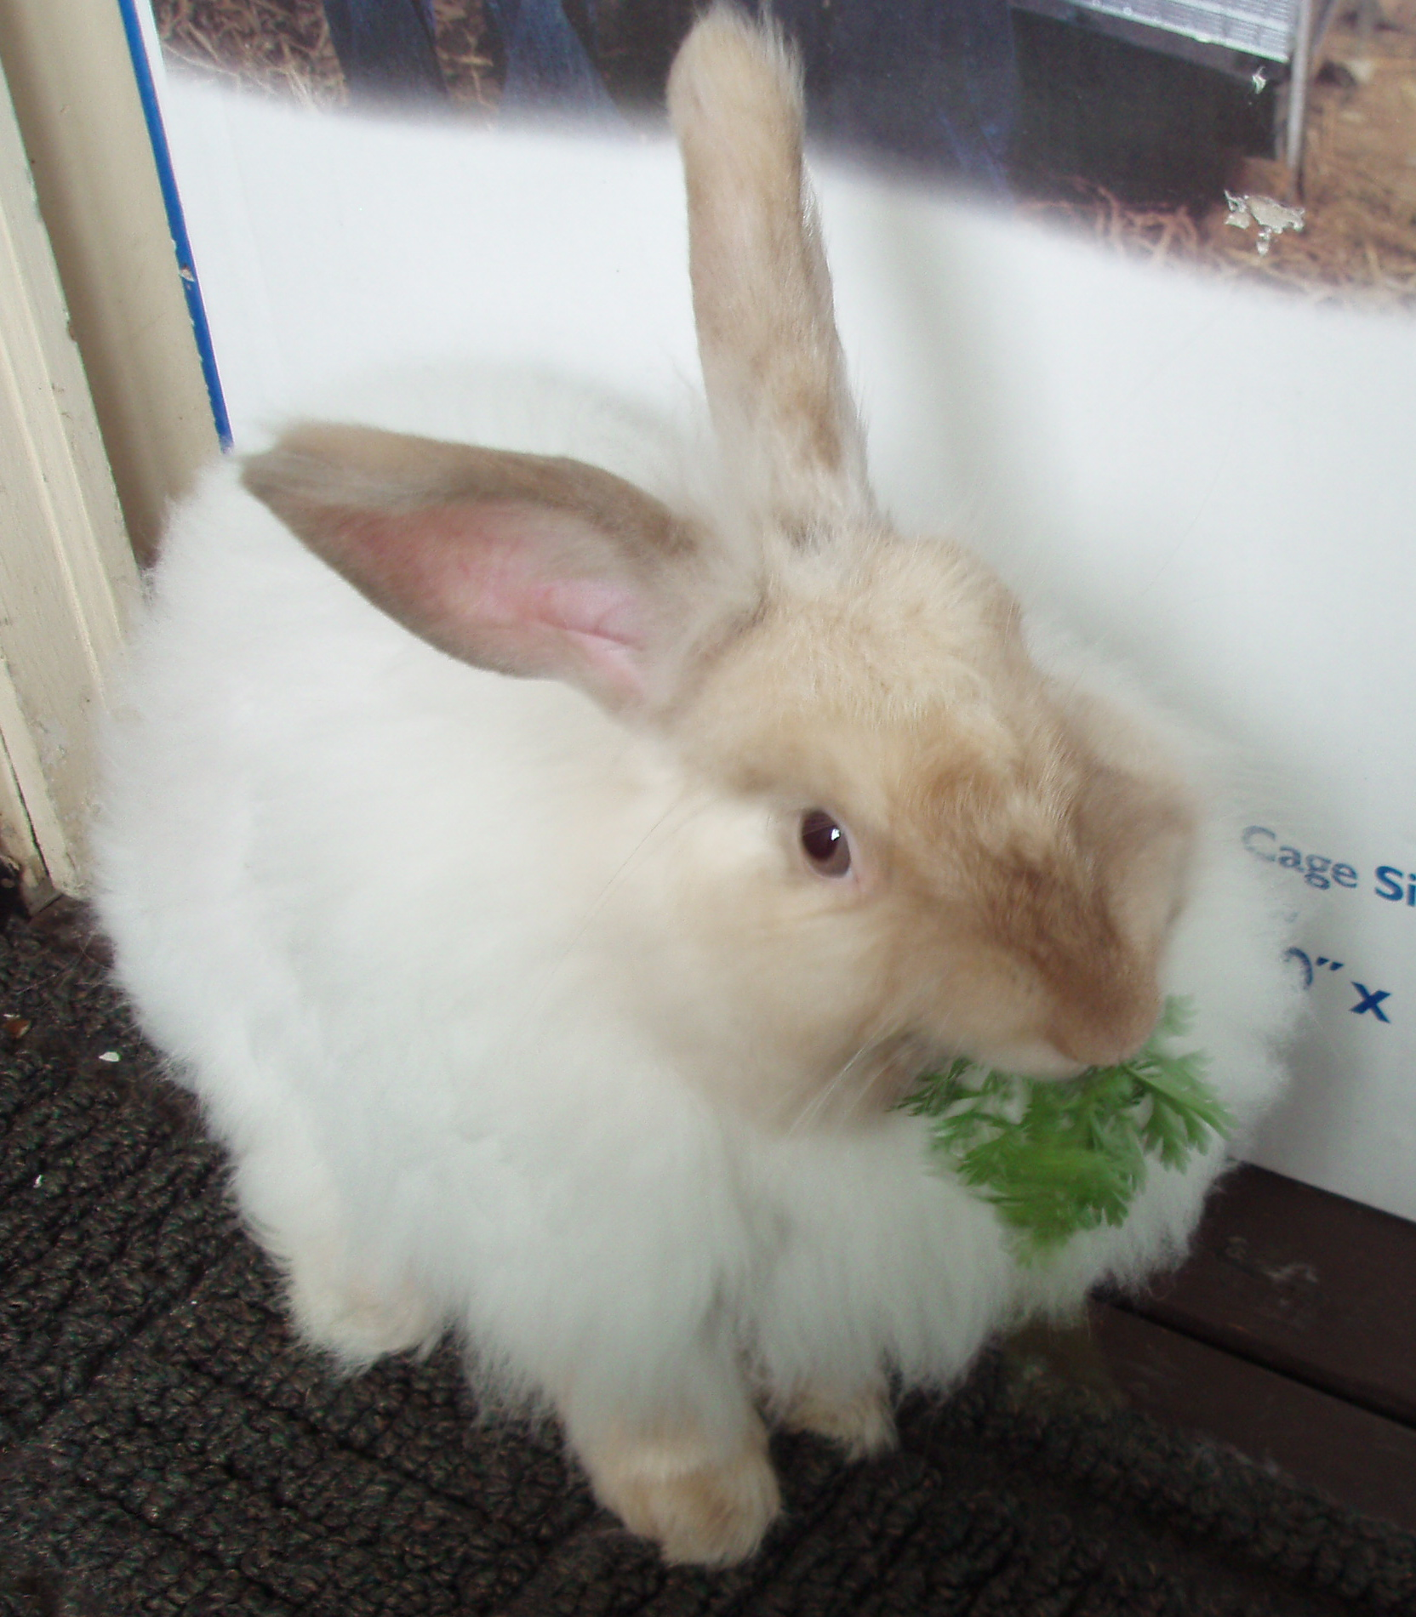
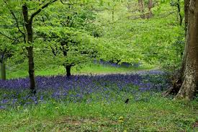
Wonderful Woodland

Slide 3
Wonderful Woodland
What is a wood?
What might you find in a wood?
Has anyone been to a wood?
Why are woodland areas important?
Can you make a list showing why woods are important?
Watch the video
In another colour add to your list the important points mentioned in the video
What were the new things on your second list?
Did anything surprise you?

