Slide 1
Conscious Consumers

Slide 2
Personalised Nutrition

Slide 3
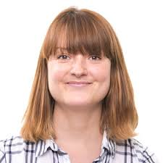
How do we eat for a healthy microbiome?
Read p.5-6 of the Conscious Consumers Workbook
Next watch the following films;
Lucy Williamson
Qualified Vet and Nutritionist, London
Lindsey Hall
Microbiologist at the Quadram Institute, Norwich
Film1: Nurturing your Inner Garden: from soil health, to gut health
Film: Introducing the microbiome
Film 2: The science behind ‘good mood food’

Slide 4
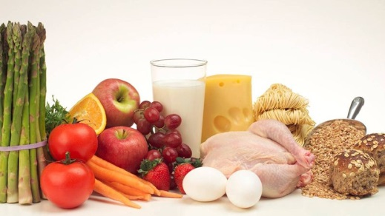
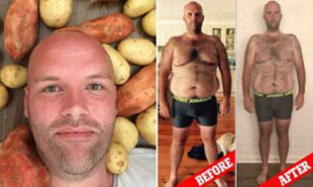
Complete the following activities
Activity 1
Activity 2
Design a microbe-boosting lunch
It could be a sandwich, soup, or anything else you would like to eat.
Try to include a wide range of prebiotic ingredients, and some probiotics too.
Add a brief summary explaining why your gut will love it.
Name and shame – fad diets
The Potato Diet
There are numerous 'fad' diets which claim to be good for us and help us lose weight.
Find three examples on the internet. Briefly explain why none of them are very good for your gut bacteria, and therefore your immune system and overall health.

Slide 5
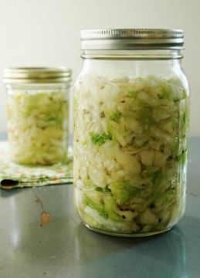
Optional Extra Activity
Fermented foods can contain probiotics for our gut - watch the following film to see how to make a basic sauerkraut using just vegetables and salt. Why not try making your own at home?!
Start with a white or red cabbage, and salt, and then add extra vegetables you like. There are lots of ideas for ingredients online.
Don’t forget to sterilise your jars!
You could also try making sourdough or yoghurt – the ingredients are cheap and easy to get hold of, and various recipes and techniques are available online.
Fermented vegetable recipe and demonstration

Slide 6
Challenge!
We hope you are feeling inspired to continue your journey through Conscious Consumerism.
If so have a go at one of the following two challenges:
Design communication materials to dispel common myths and help people gain a better understanding of the topic. This could be in the form of a blog, a poster, leaflets or a podcast for example.
Develop a campaign to collect real data and report your findings or to encourage people or companies to change behaviours. For example, you could collect data from your school canteen to measure the food miles of the ingredients used, or you could create recipe cards to feed your gut microbes.
See page 11 of the workbook for more details!
These resources were produced
by;
Supported by;
Funded by;

